Slide 1

Customer RFM Segmentation Case Study
Using RFM Analysis to Uncover Customer Value & Drive Retention

Slide 2
Analysis Overview
The Challenge
The Goal
A retail food company struggled with:
Identify actionable, data-driven customer segments to guide targeted retention strategies and maximize customer lifetime value
Low retention among high-value customers
No personalization in marketing campaigns
Unclear value distribution across customer base
Unfocused marketing spend

Slide 3
The Problem
Uniform Treatment
Behavior Blind Spots
All customers treated the same marketing approach regardless of value or behavior
Little insight into purchasing patterns or customer journey
Value Leakage
Wasteful Spend
High-value customers slipping into at-risk categories unnoticed
Marketing budget spread too broadly with limited return

Slide 4
Data Foundation
Sources
Feature Engineering
Customer demographics table
01
02
Sales table with recency, frequency and revenue / order information
Recency
Frequency
Days since last purchase
Total number of transactions
Preparation Steps
03
Data cleaning (missing values, formatting, merging)
Monetary
Total revenue per customer
Exploratory analysis

Slide 5





Our Analytical Approach
SQL Aggregation
Customer-level metrics calculated using PostgreSQL
EDA
Explored behavior patterns and distributions
RFM Scoring
Assigned scores based on purchase behavior
Segmentation
Classified into 10 actionable customer groups
Dashboard
Built interactive Power BI visualization

Slide 6
RFM Segmentation Logic
Recency Score
Frequency Score
Monetary Score
How recently did the customer purchase?
How often does the customer buy?
How much does the customer spend?
Score 1-5
Score 1-5
Score 1-5
5 = most recent
5 = most frequent
5 = highest spender
1 = least recent
1 = least frequent
1 = lowest spender
Split into 5 equal groups
Split into 5 equal groups
Split into 5 equal groups
10 Customer Segments Identified
Loyalist • Potential Loyal • New Customer • Growing • Promising • Established Spender • Big Spender • Loyal (At Risk) • Customer At Risk • Lost

Slide 7
Key Customer Segments
Loyalists
Big Spenders
Frequent buyers with recent activity and high spend
High monetary value, less frequent purchases
Established Spenders
At-Risk Customers
Consistent, reliable revenue contributors
Previously valuable, now showing declining activity
New & Promising
Lost Customers
Recent or first-time buyers with growth potential
Low activity, very low recent engagement

Slide 8
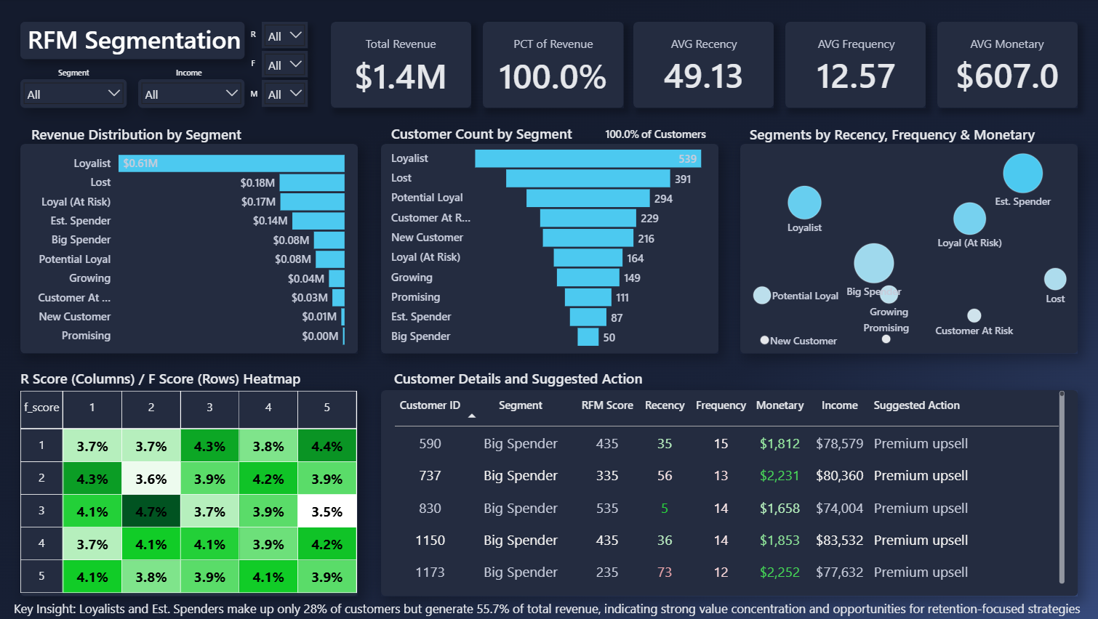
Interactive Dashboard Overview
1
KPI Summary
4
Dynamic Slicers
Core metrics: Total customers, total revenue, avg monetary value, avg frequency value, avg monetary value
Filter by segment, income level, and RFM score
2
Distribution Visuals
Segment breakdowns, revenue contribution by group
3
RFM Bubble Chart
Visual positioning of segments by behavior scores
showing customer quality and engagement at a glimpse

Slide 9
Key Insights
28%
87.6%
$1.6K
High Value Core
Revenue Concentration
Premium Value
Loyalists and Established Spenders represent just 28% of customers but generate 55.7% of revenue
Customer in highest income groups (50k+) bring in 87% of revenue at only 51% of customers
Average spend among Big Spenders and Established Spenders
15.3%
7.12
$173k
At-Risk Revenue
Low Income Low Frequency
Lost Value
At-risk group still contributing significant revenue offering a strong opportunity for win back strategies
Average frequency of Low-income group (20k – 50k)
Total revenue generated by customers segmented as lost

Slide 10

Strategic Recommendations
1
Strengthen Loyalty Programs
Offer VIP perks, exclusive offers, and early access for Loyalists and Established Spenders
2
Launch Win-Back Campaigns
Use personalized outreach and targeted incentives to re‑engage At‑Risk and Lost customers.
3
Upsell Premium Bundles
Curated product packages and high-margin items to increase average order value for Big Spenders
4
Nurture New Customers
Welcome incentives, onboarding sequences, and engagement campaigns to guide New and Promising segments

